Slide 1




Genetically Engineered ELP-AMP Protein Polymers for Antimicrobial Materials
Miguel Pena – Biomedical Engineering
Mentor: Minkyu Kim, Ph.D. – Biomedical Engineering, and Materials Science and Engineering.
Project Lead: Chris Camp (Ph.D. Student) – Biomedical Engineering
Support: Vy Nguyen (Undergraduate) – Biomedical Engineering
2018 NASA Space Grant Symposium
April 14, 2018

Slide 2
Summary of Presentation
A major obstacle to overcome
How to approach it
What we plan to accomplish
Our results so far
Expected results
What the future holds

Slide 3
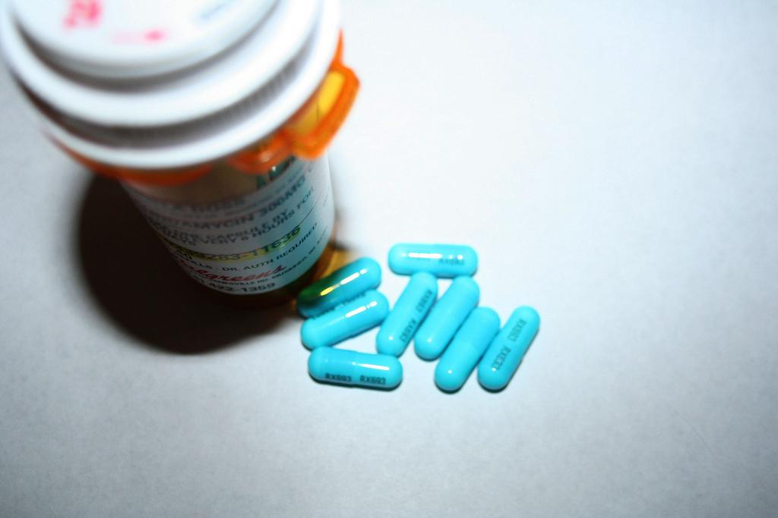
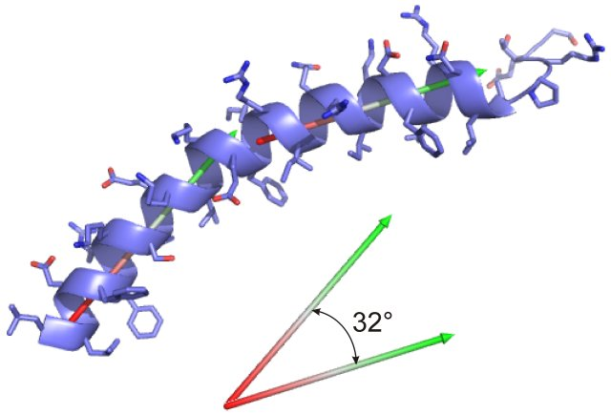
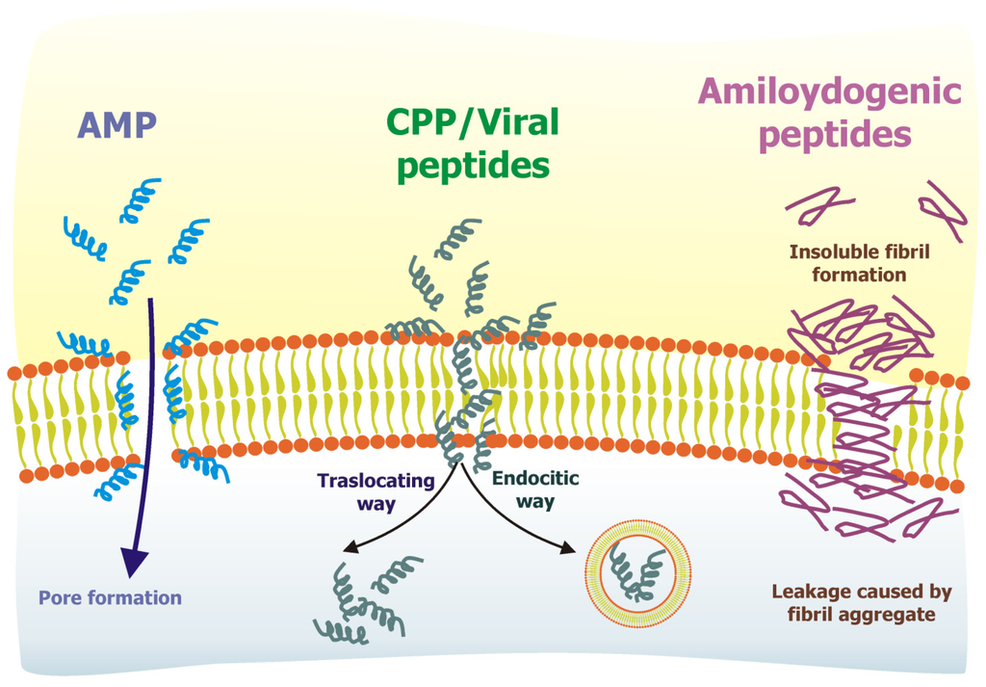
Antimicrobial Resistance
What is it? Why it matters. Alternatives to antimicrobial medications. Our solution.

Slide 4
Antimicrobial Peptides (AMP)

Slide 5
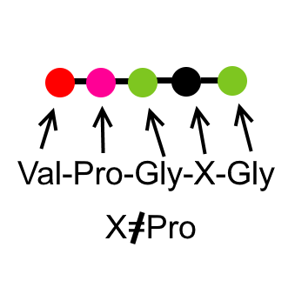
Our Solution
Elastin-like Polypeptide (ELP)

Slide 6
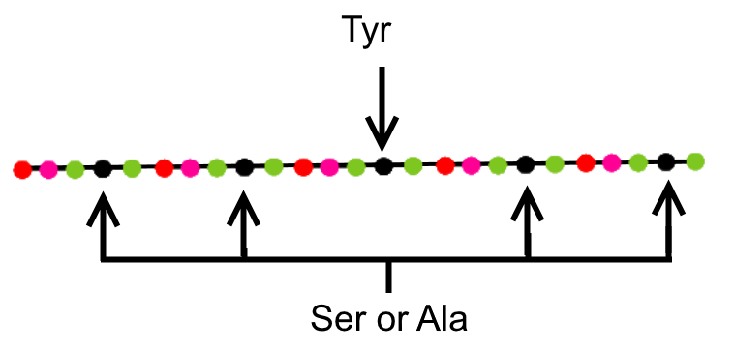
Our Solution

Slide 7
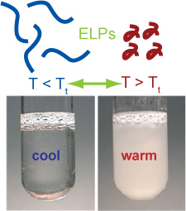
Our Solution
ELP
x8,x16,x24, or x36
Provided by Chris Camp

Slide 8
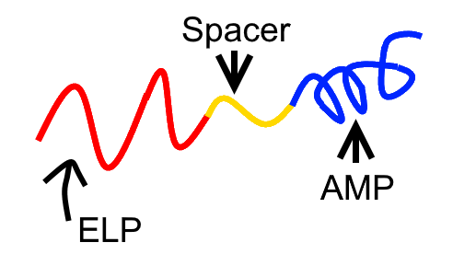
Our Solution
ELP

Slide 9

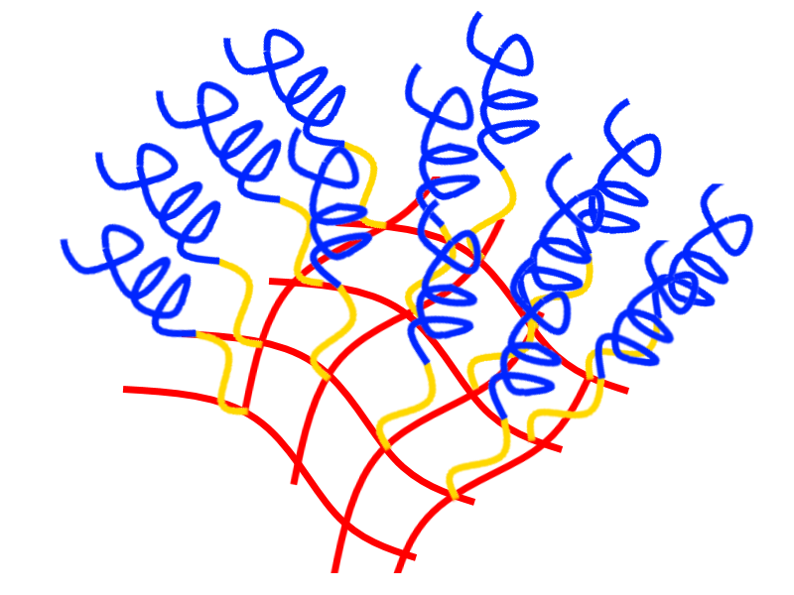
Our Solution
Inject into bloodstream
Crosslink with ultraviolet light

Slide 10
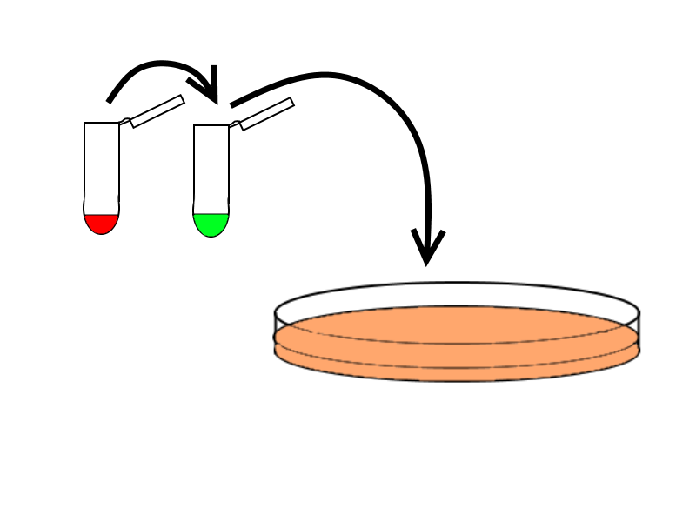
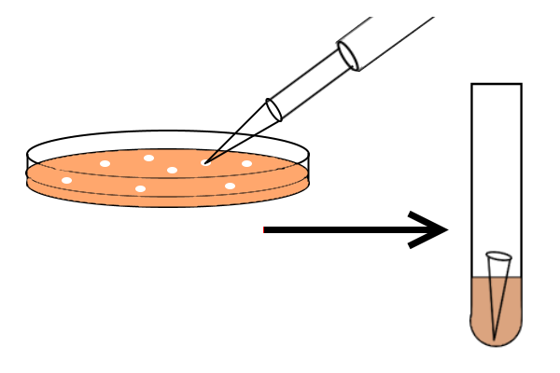
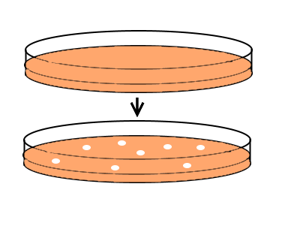
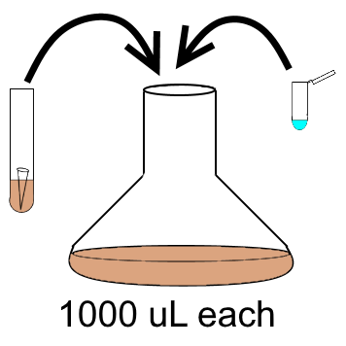
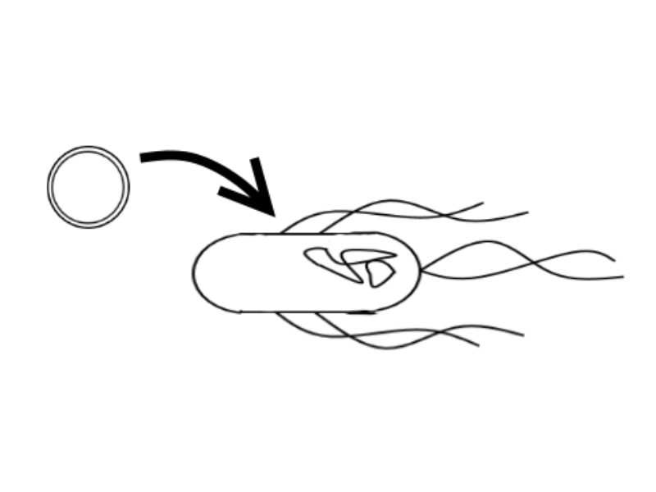
Methods
Exploit the fast reproductive system of bacteria to mass produce our protein

Slide 11
Methods
Isolate the cells by using a centrifuge
Break open the cells using sonification
Extract our protein through inverse transition cycling (ITC) purification
Confirm pure sample using protein gels

Slide 12
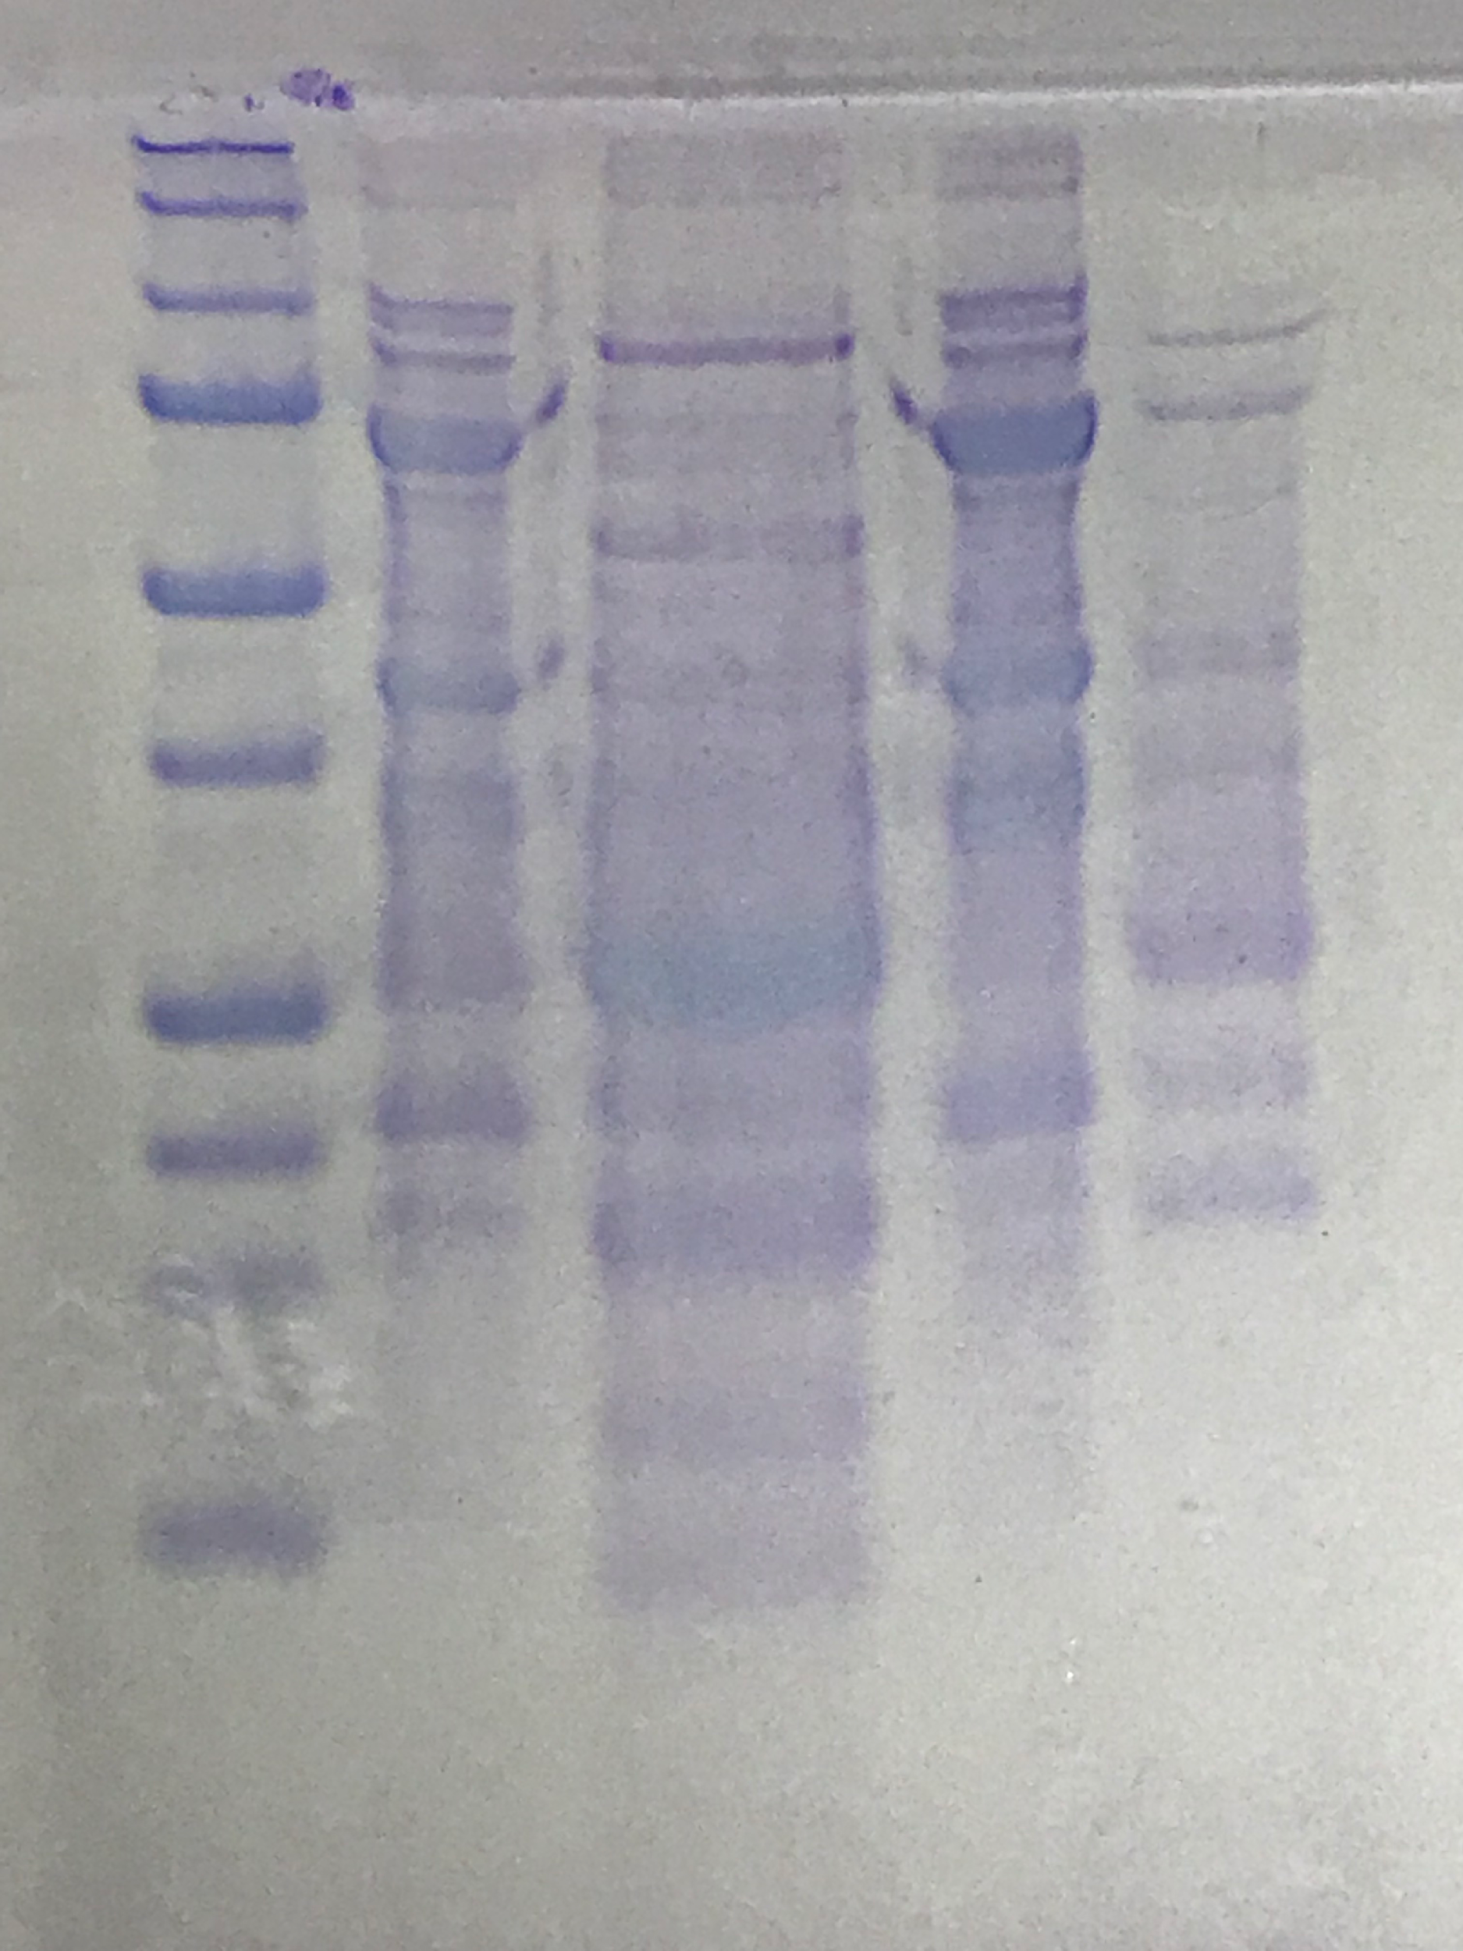

Preliminary Results
Size Std (kDa)
HisTag
LL37-8x
Size Std (kDa)
50C Precip
50C Soluble
4C Precip
4C Soluble
S2YS2-H-24x-LL37 ITC Purification
~50C for 10 minutes -> 4C for 10 minutes, pipetting to mix
Provided by Chris Camp

Slide 13
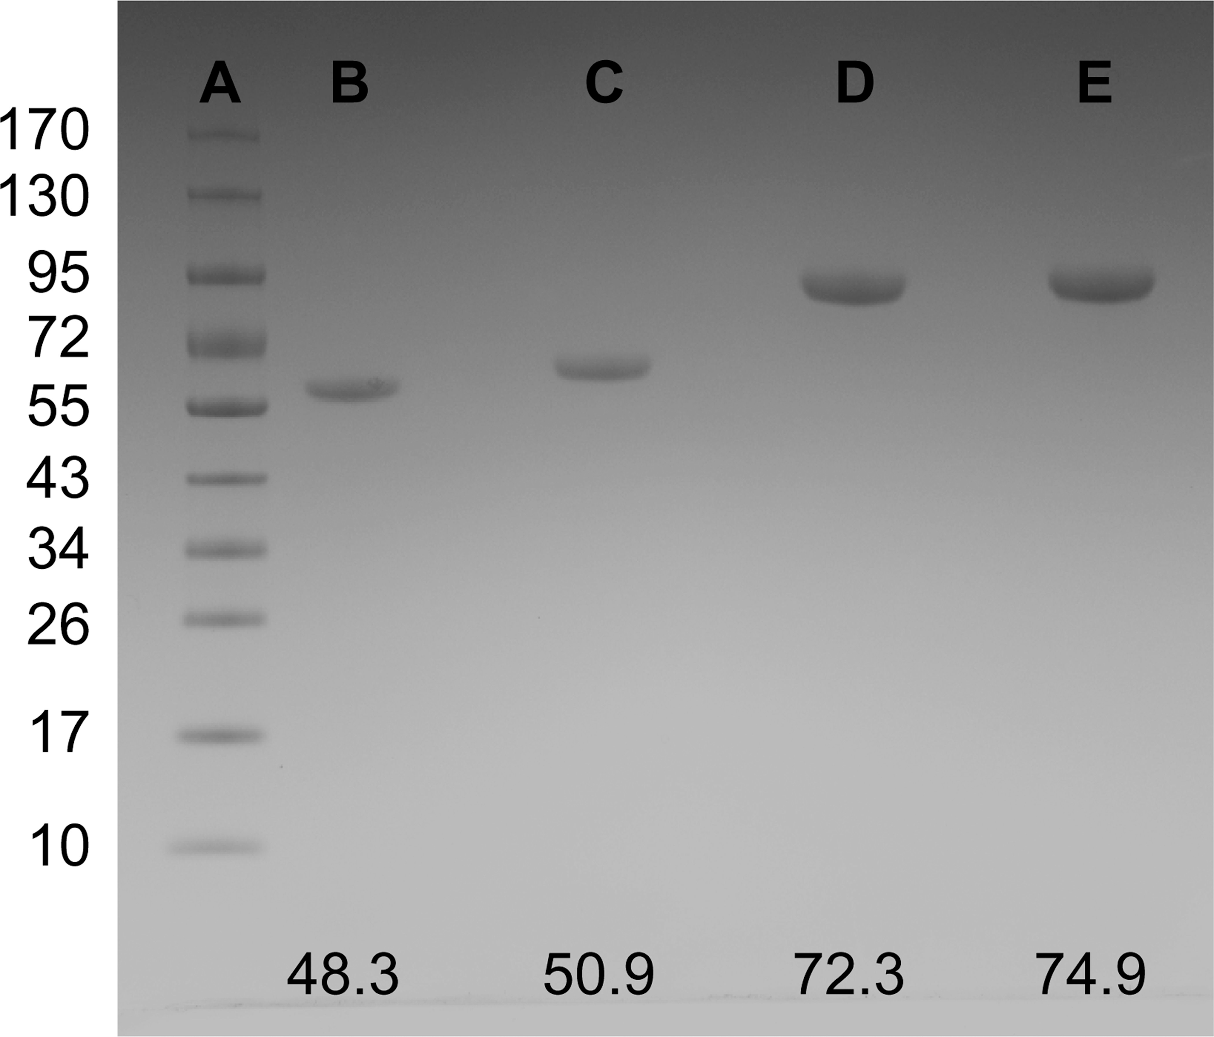
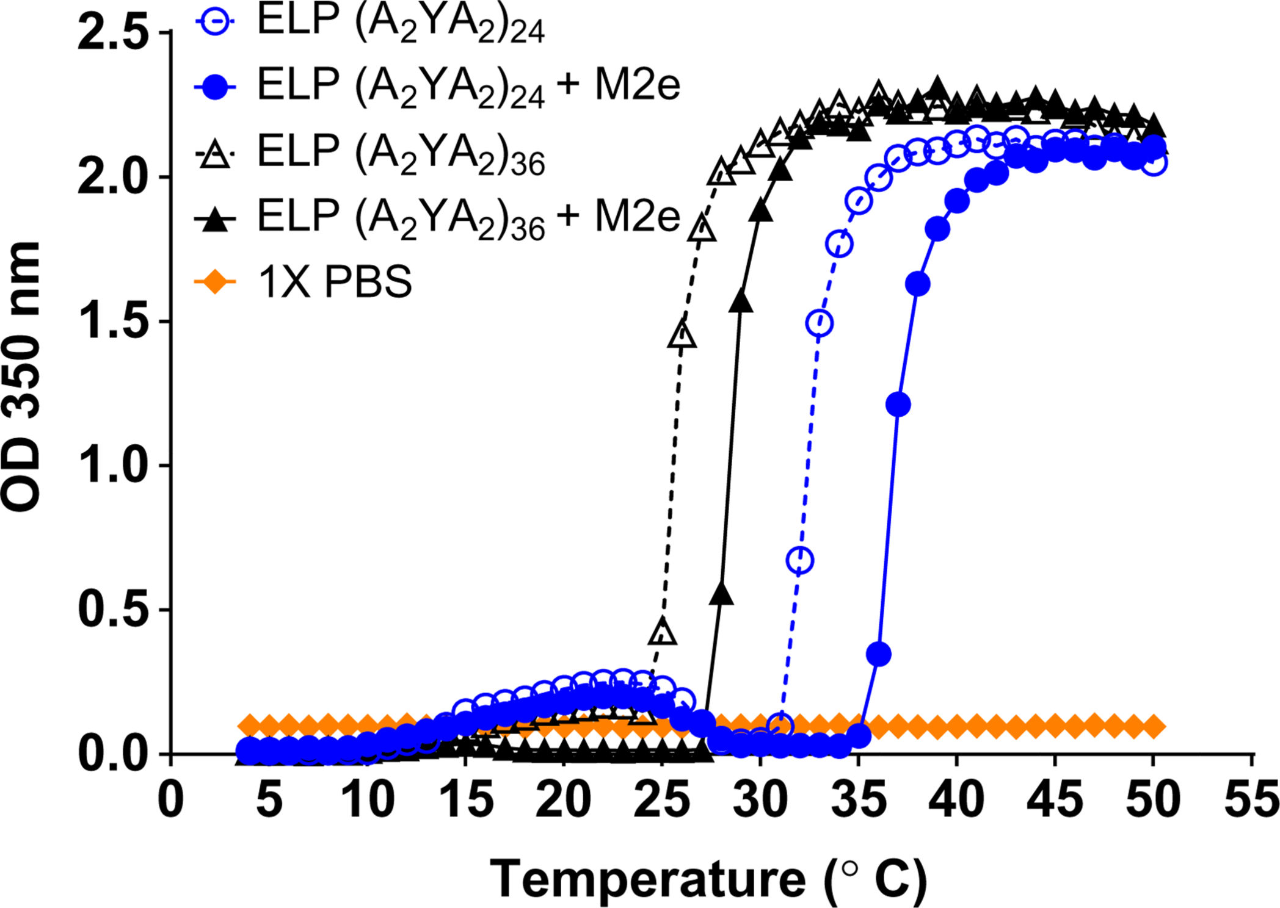
Expected Results
Texas Tech University, (Ingrole et al., 2014)

Slide 14
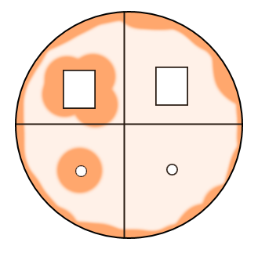
Expected Results
Zone of inhibition shows where bacterial growth was inhibited
We could potentially compare our film to antibiotics
If it does not work, then we would see top right
Top view of a petri dish

Slide 15
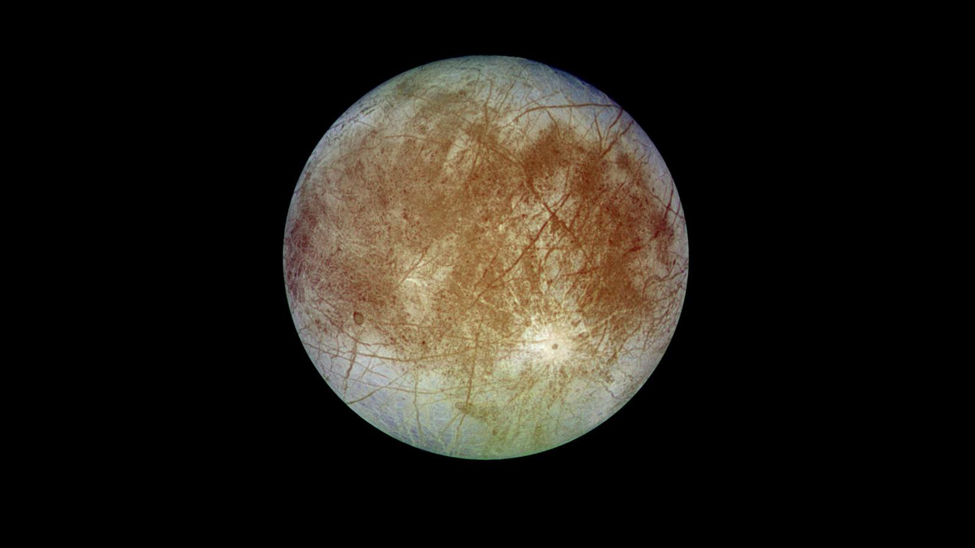
Potential Future Applications
Air filtration system
Antimicrobial surfaces for spacecraft
Treatment for serious infections
Sterile implants

Slide 16
Thank You
Miguel Pena
mp323@email.arizona.edu

